Slide 1
COMS 4995 - Applied Machine Learning
Project Deliverable #2 - Data Analysis and Visualization
Team 10

Slide 2
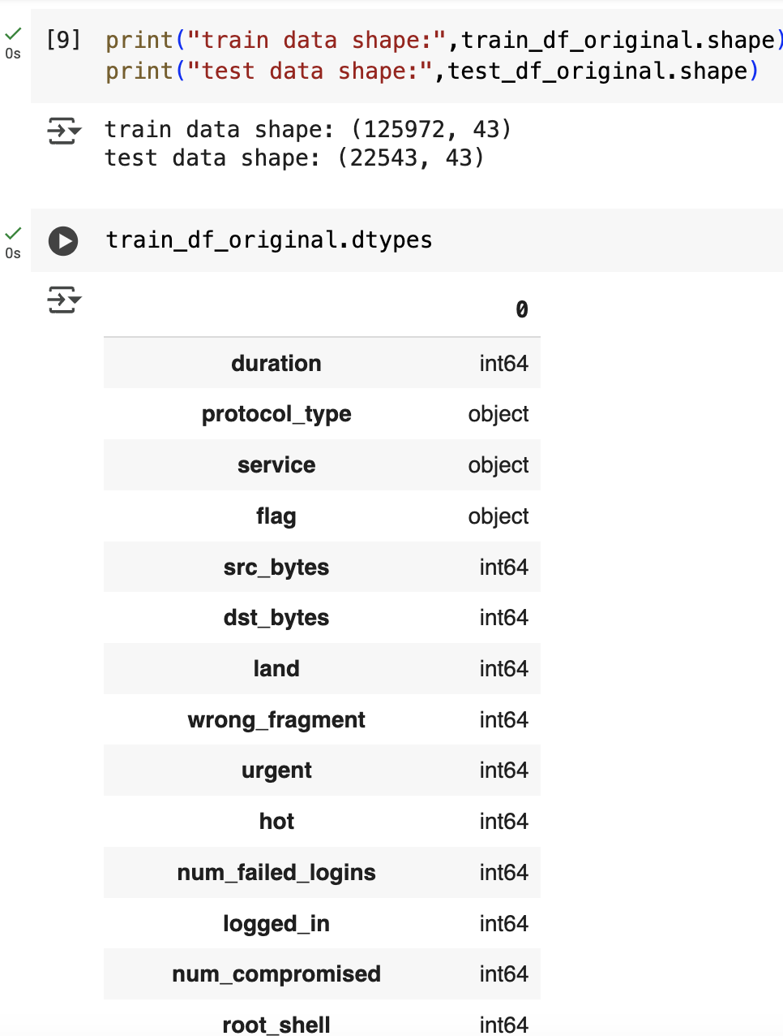
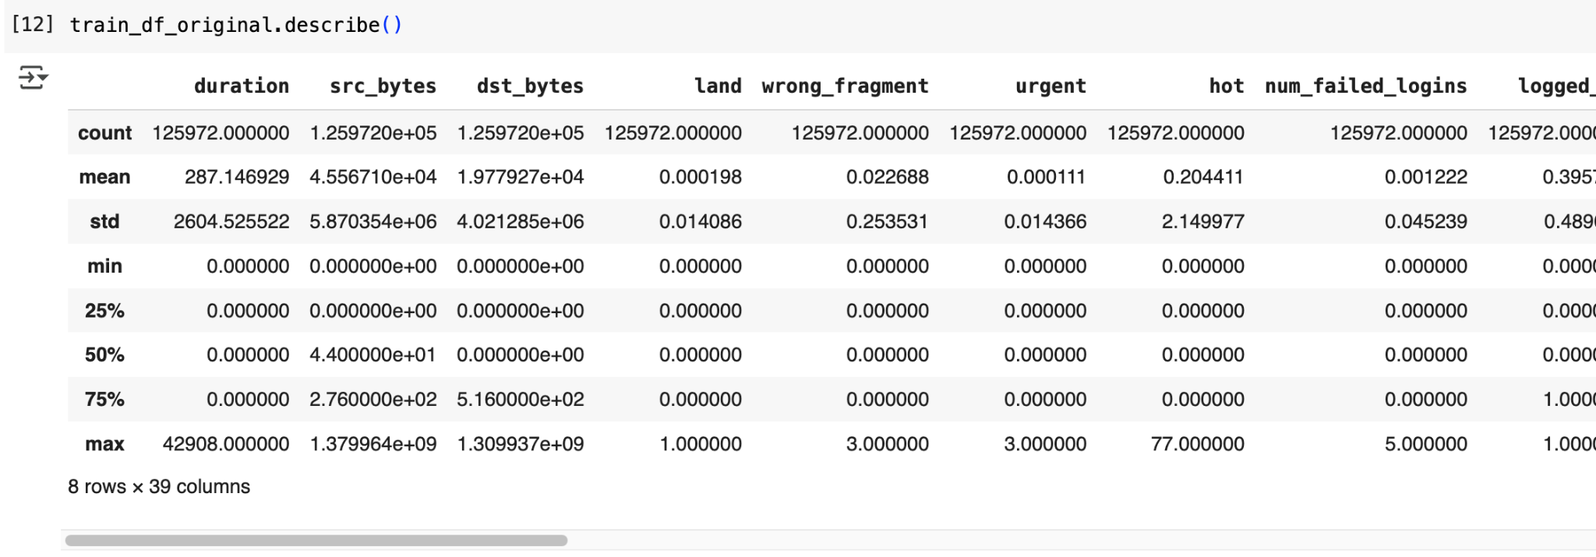
INITIAL DATA EXPLORATION & INSIGHTS – DATASET SHAPE & SUMMARY
Shape and data types of the dataset
Train set: 125,972 rows, 43 columns
Test set: 22,543 rows, same schema
No missing values detected
Feature types: mostly numerical, some categorical (protocol_type, service, flag)
Summary stats show high variance (src_bytes, dst_bytes)
Several binary features are zero-dominant
Statistics of the dataset

Slide 3
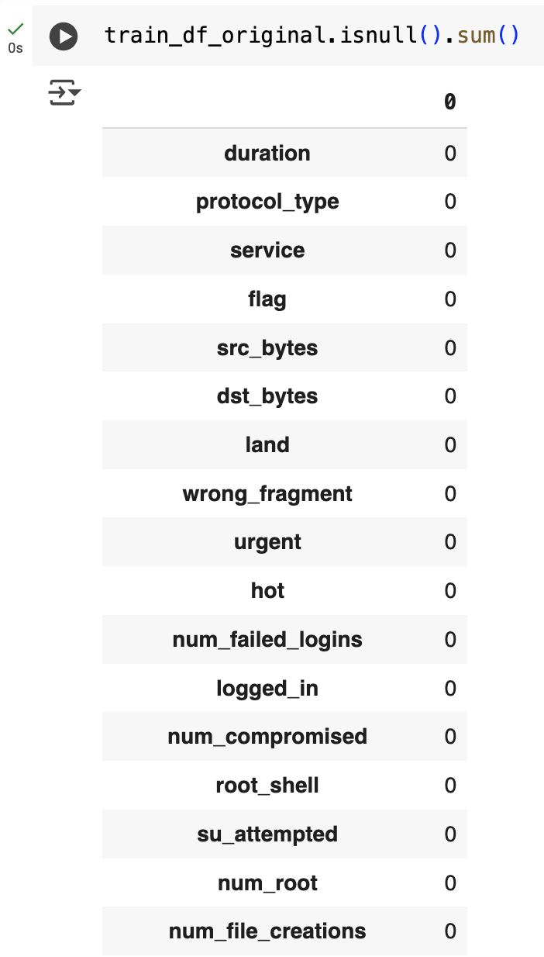
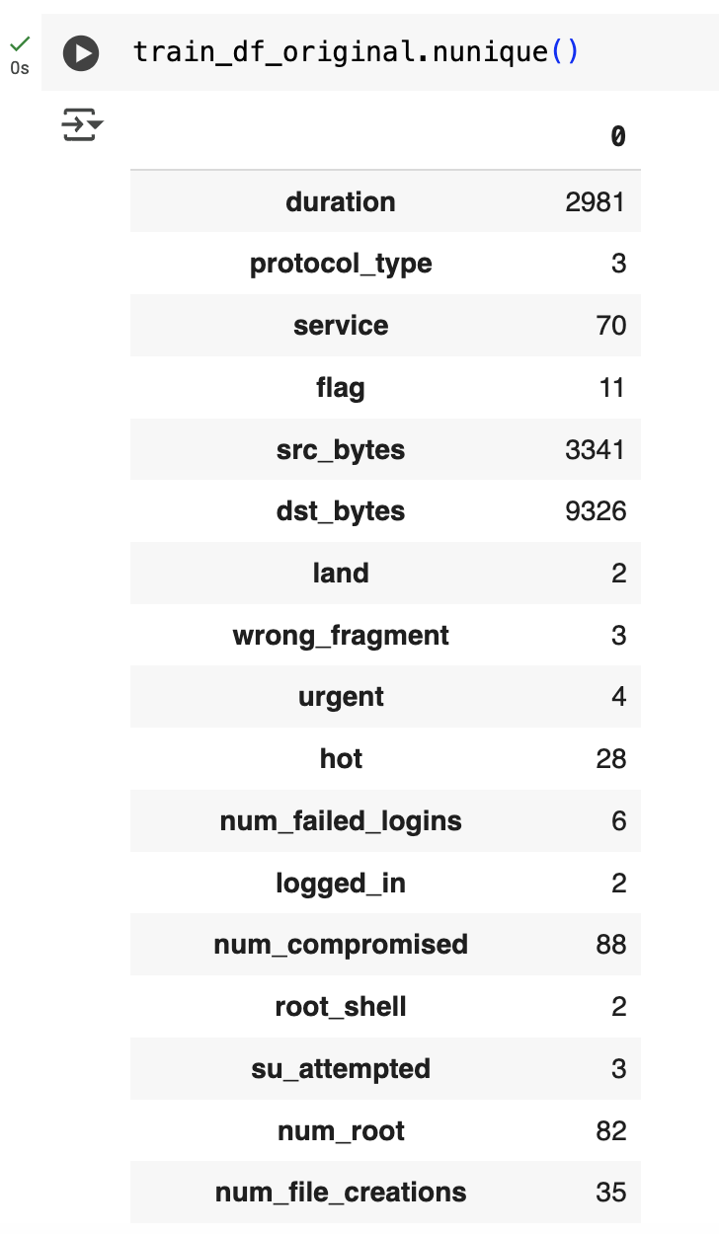
Initial Data Exploration & Insights – Missing Values & Feature Uniqueness
Feature Uniqueness
Some features have low cardinality ( protocol_type, flag) → Categorical Others have thousands of unique values (dst_bytes, src_bytes) → Continuous Will guide encoding strategy and feature selection
NaNs in the dataset
#Unique values in each feature in the dataset

Slide 4
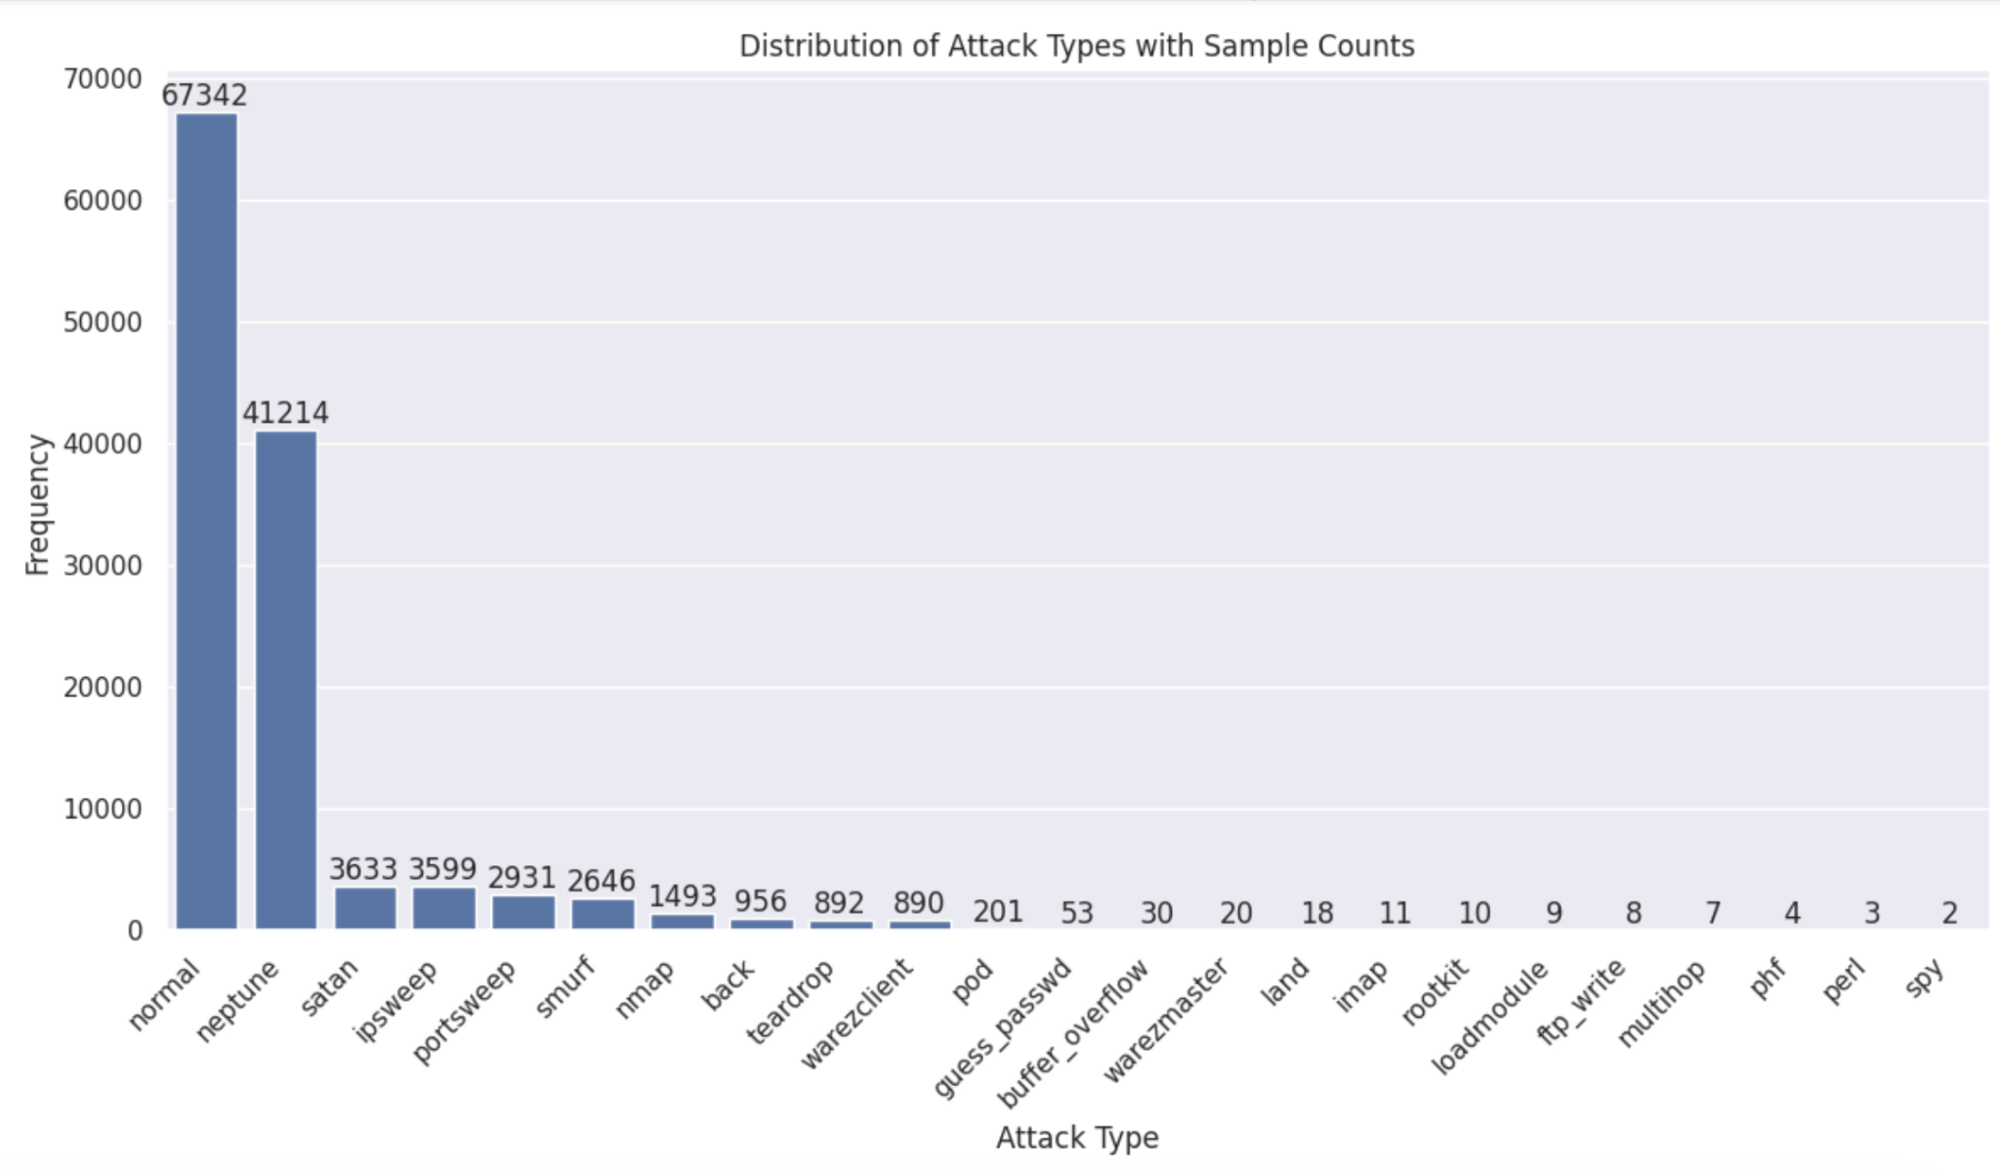
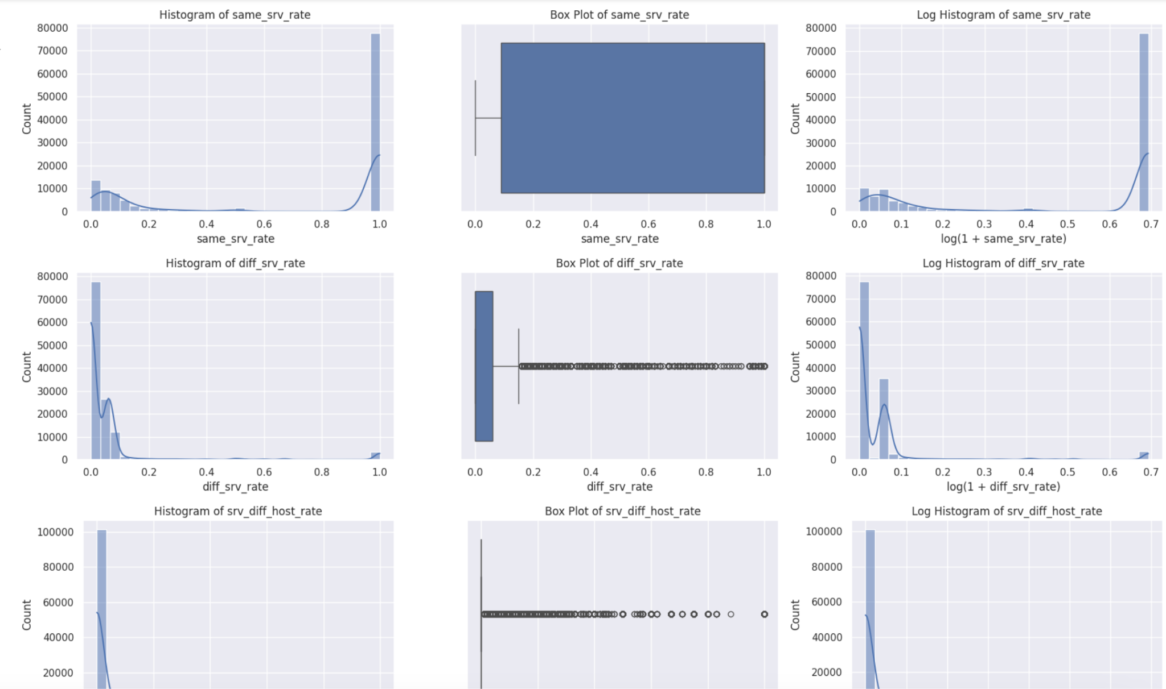
Distribution of target feature (Attack type)
Histogram, Boxplots and Log histogram for numeric features
Target class (attack) is heavily imbalanced
Normal + DoS dominate (over 85% of samples)
Rare attacks like spy, perl severely underrepresented
Will influence sampling strategy
Numerical features show skewed distributions Presence of outliers → visible in boxplots Log transformation improves feature scale Helps with modeling techniques sensitive to distribution

Slide 5
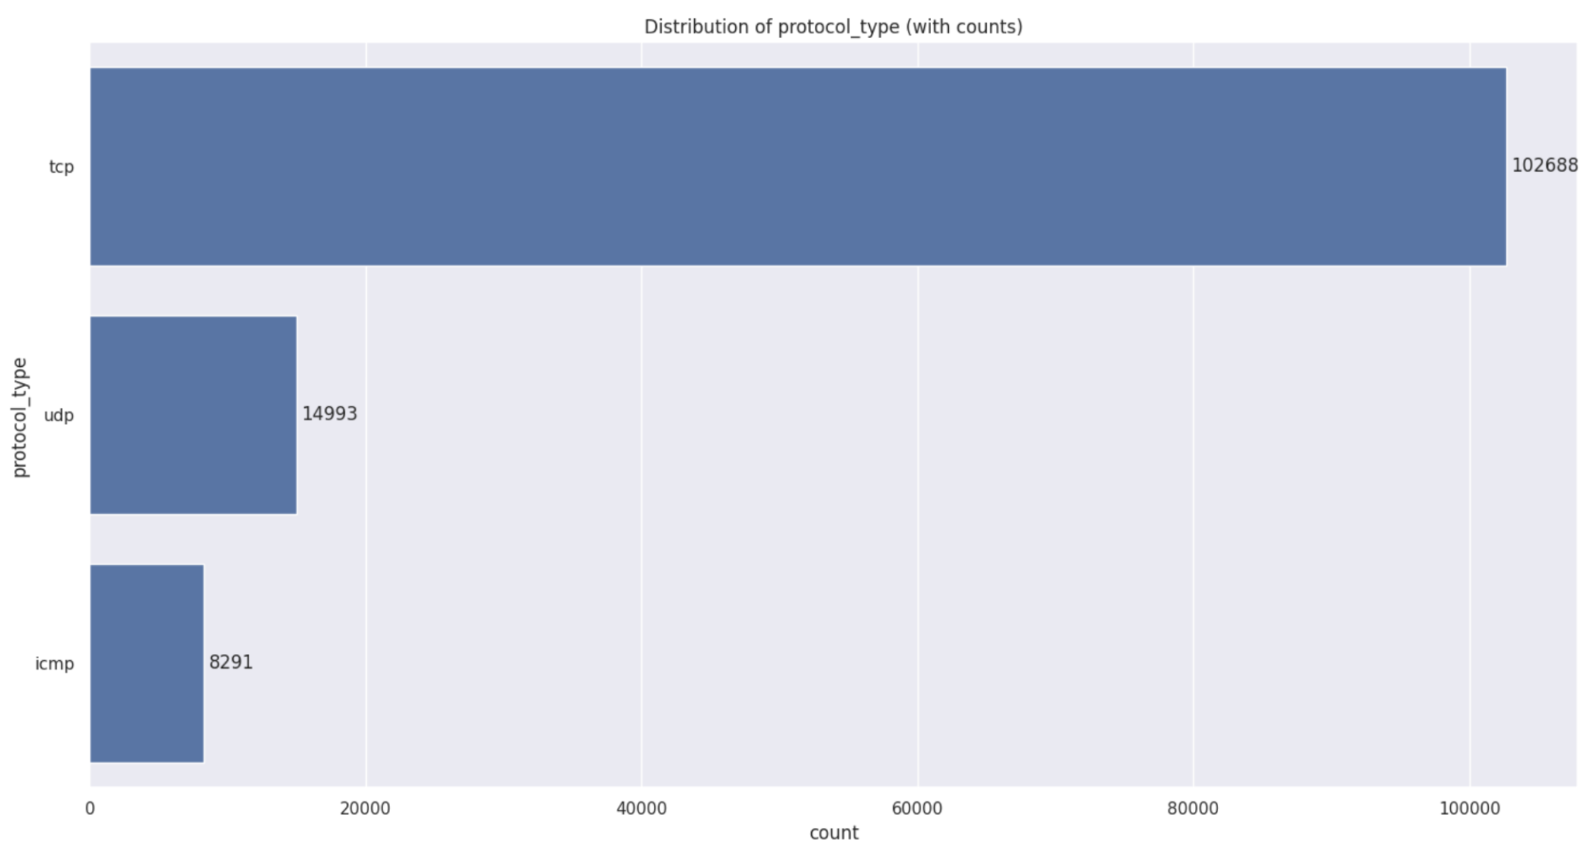
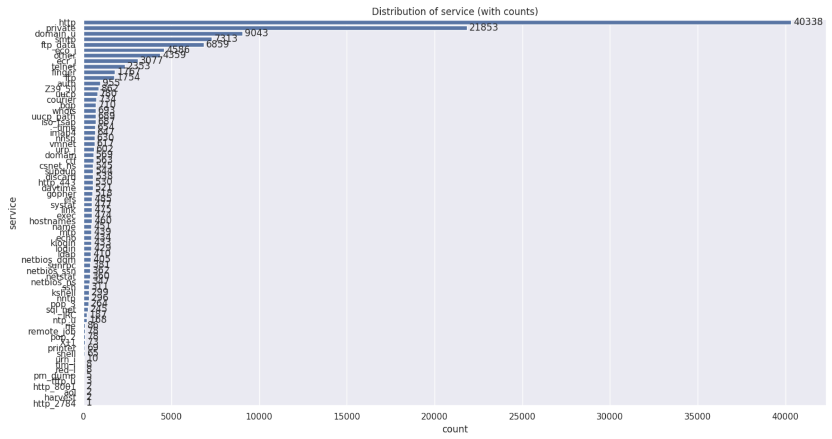
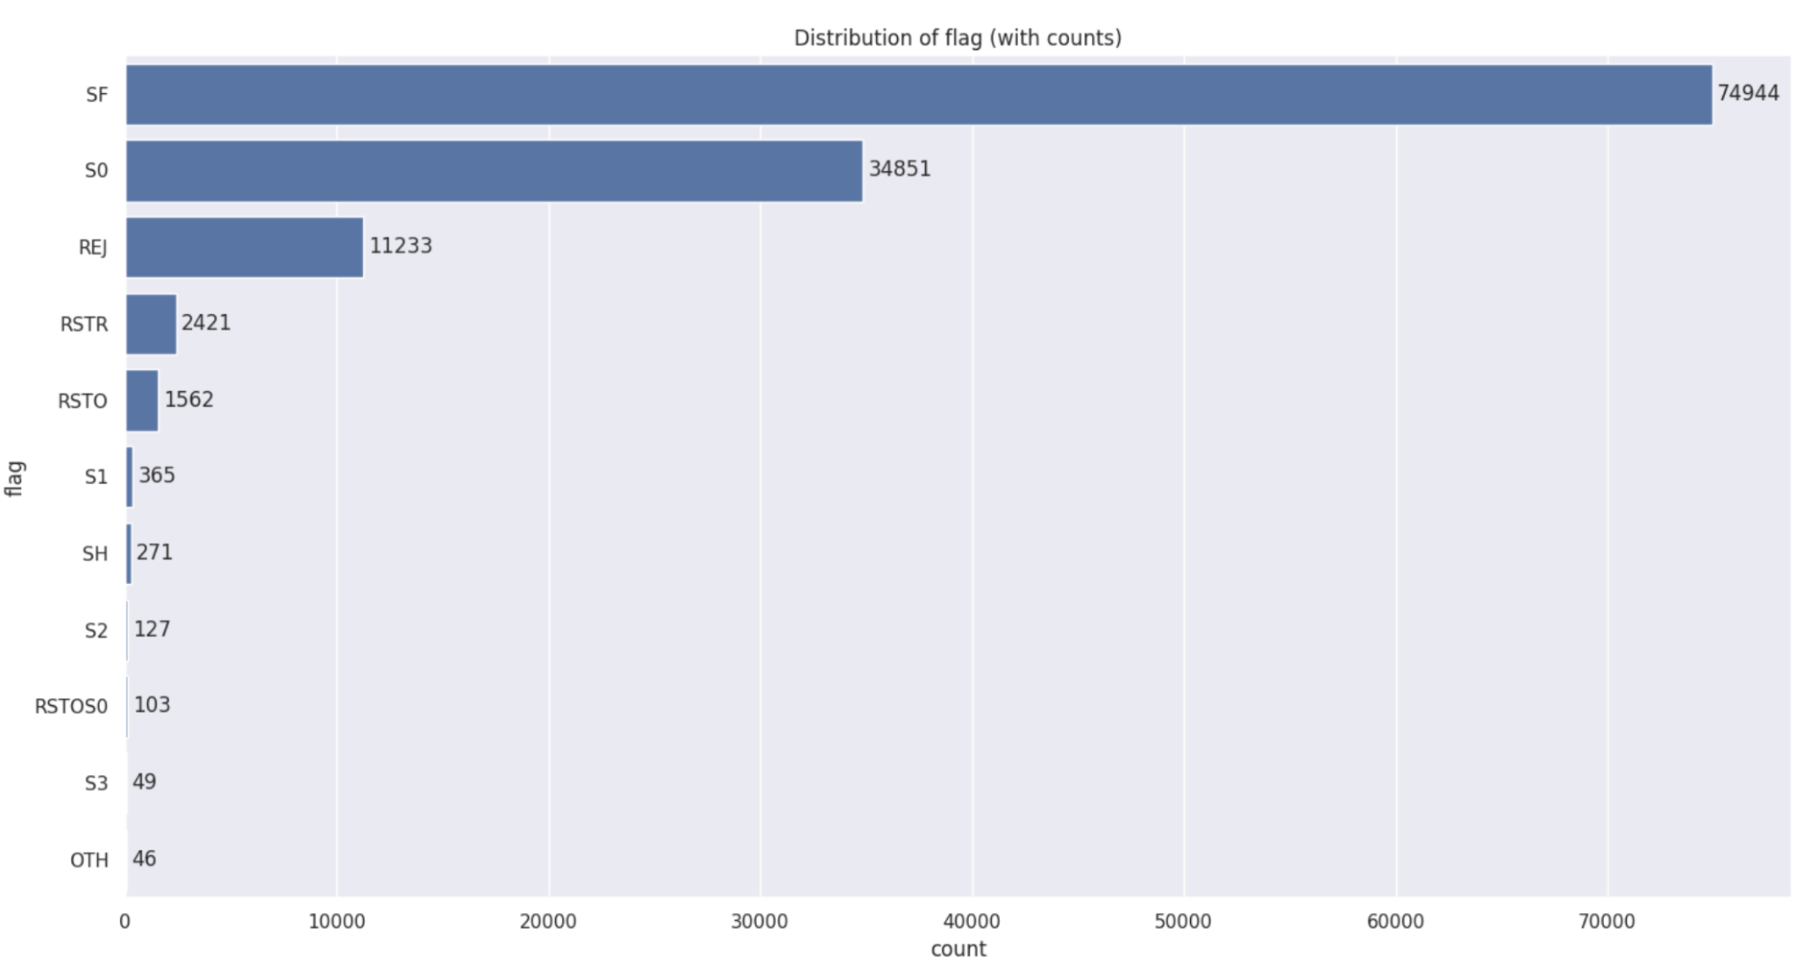
Categorical Feature Distribution – protocol type, service, flag
70 unique values, highly skewed distribution
Services like http, domain_u, private dominate
Most services have very low frequency → long tail risk
May require grouping or dimensionality reduction
11 types of connection status flags
SF and S0 account for ~87% of connections
Flags offer meaningful patterns for intrusion classification
protocol type
Only 3 categories: tcp, udp, icmp
tcp dominates the dataset (>80%)
Indicates a strong protocol bias in captured traffic

Slide 6
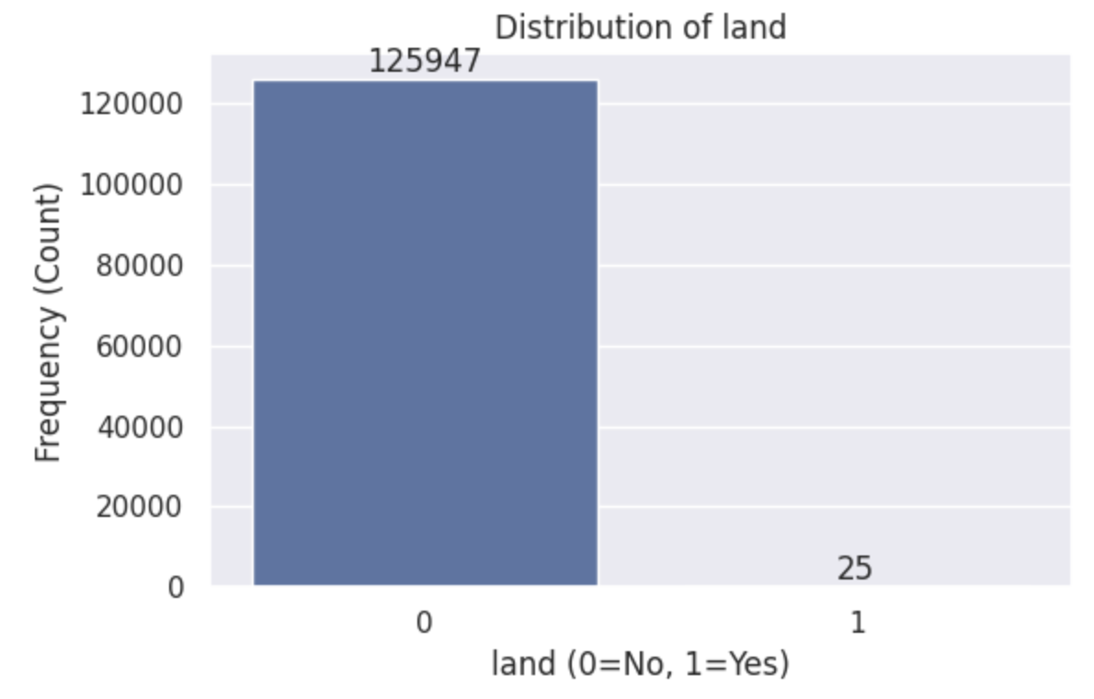
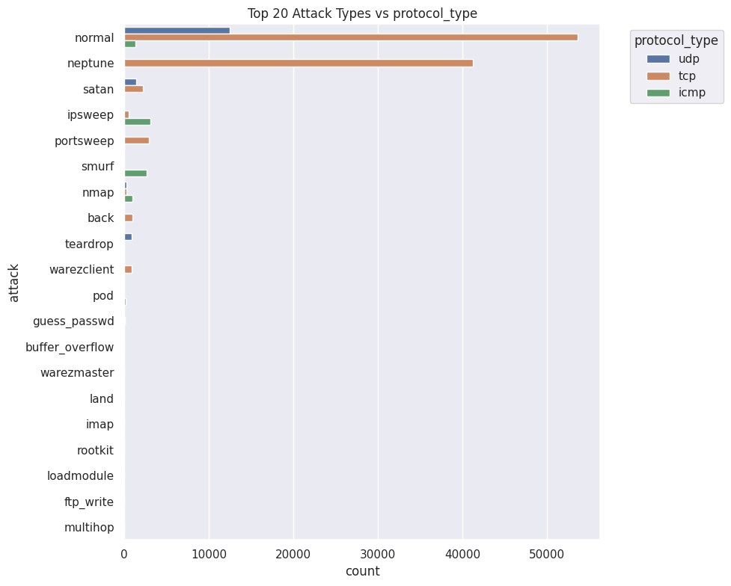
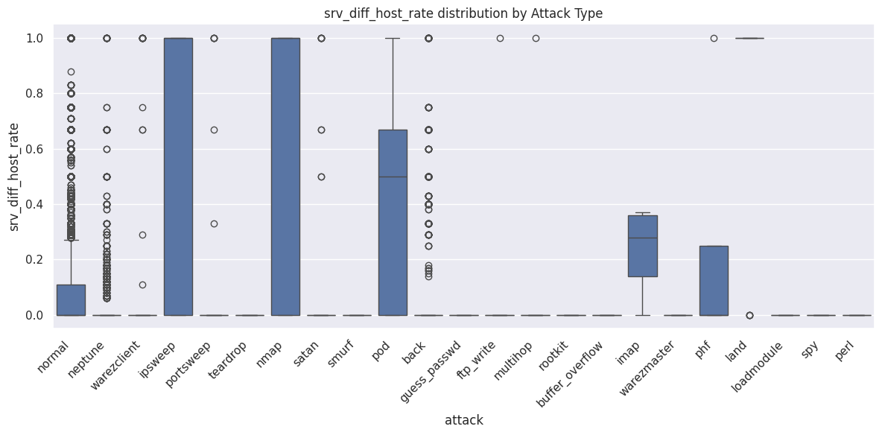
Binary Variables Exploration
Bivariate Analysis - Categorical features vs. target variable
Bivariate Analysis - Continuous features vs. target variable

Slide 7
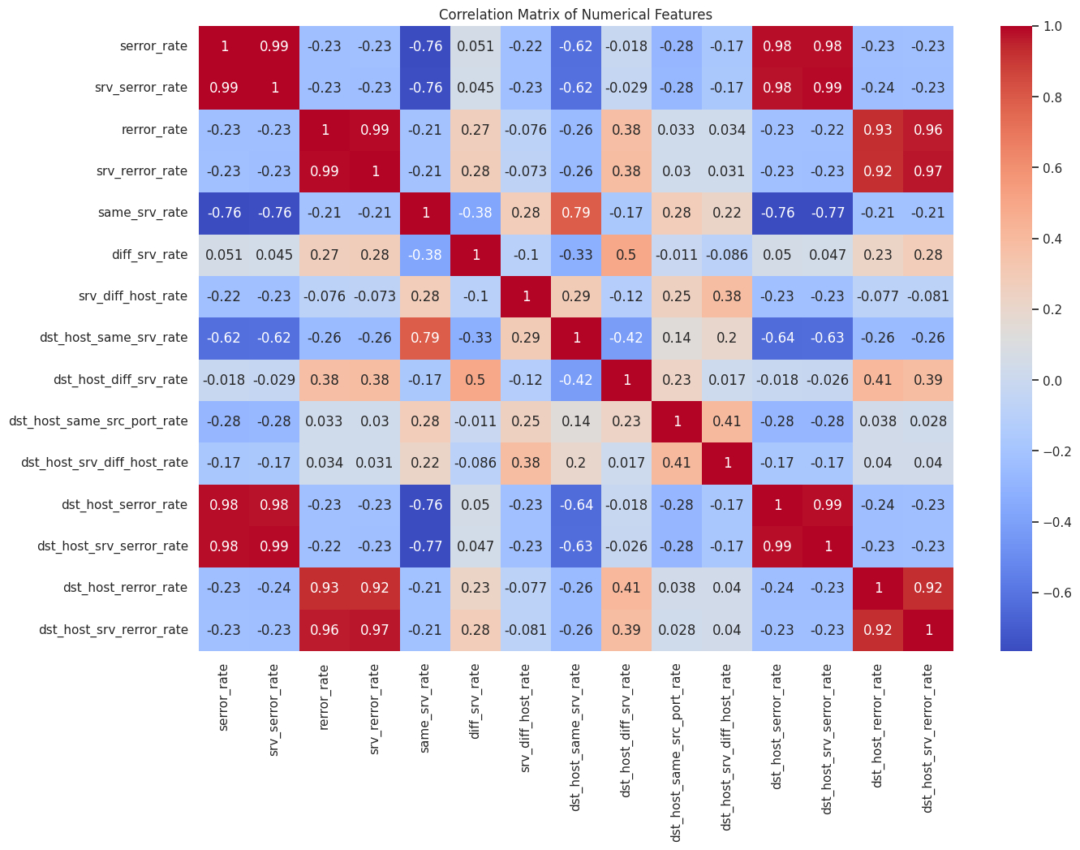
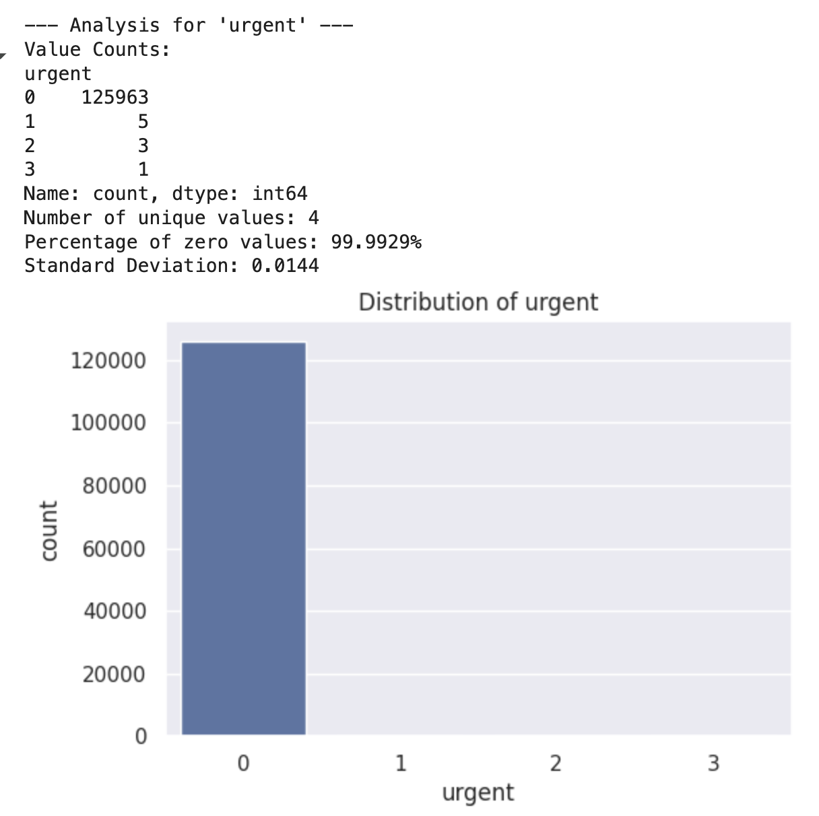
Feature Redundancy & Sparsity Analysis
Sparsity
Correlation matrix
Highly Correlated Features
Some pairs have near-perfect correlation
Suggests possible feature redundancy
May apply correlation-based feature pruning or PCA
Sparse Feature Example – urgent
99.99% of entries are zero Only 4 unique values, very low variance Could be removed or grouped, depending on model sensitivity Similar checks done on other sparse/binary feature

Slide 8
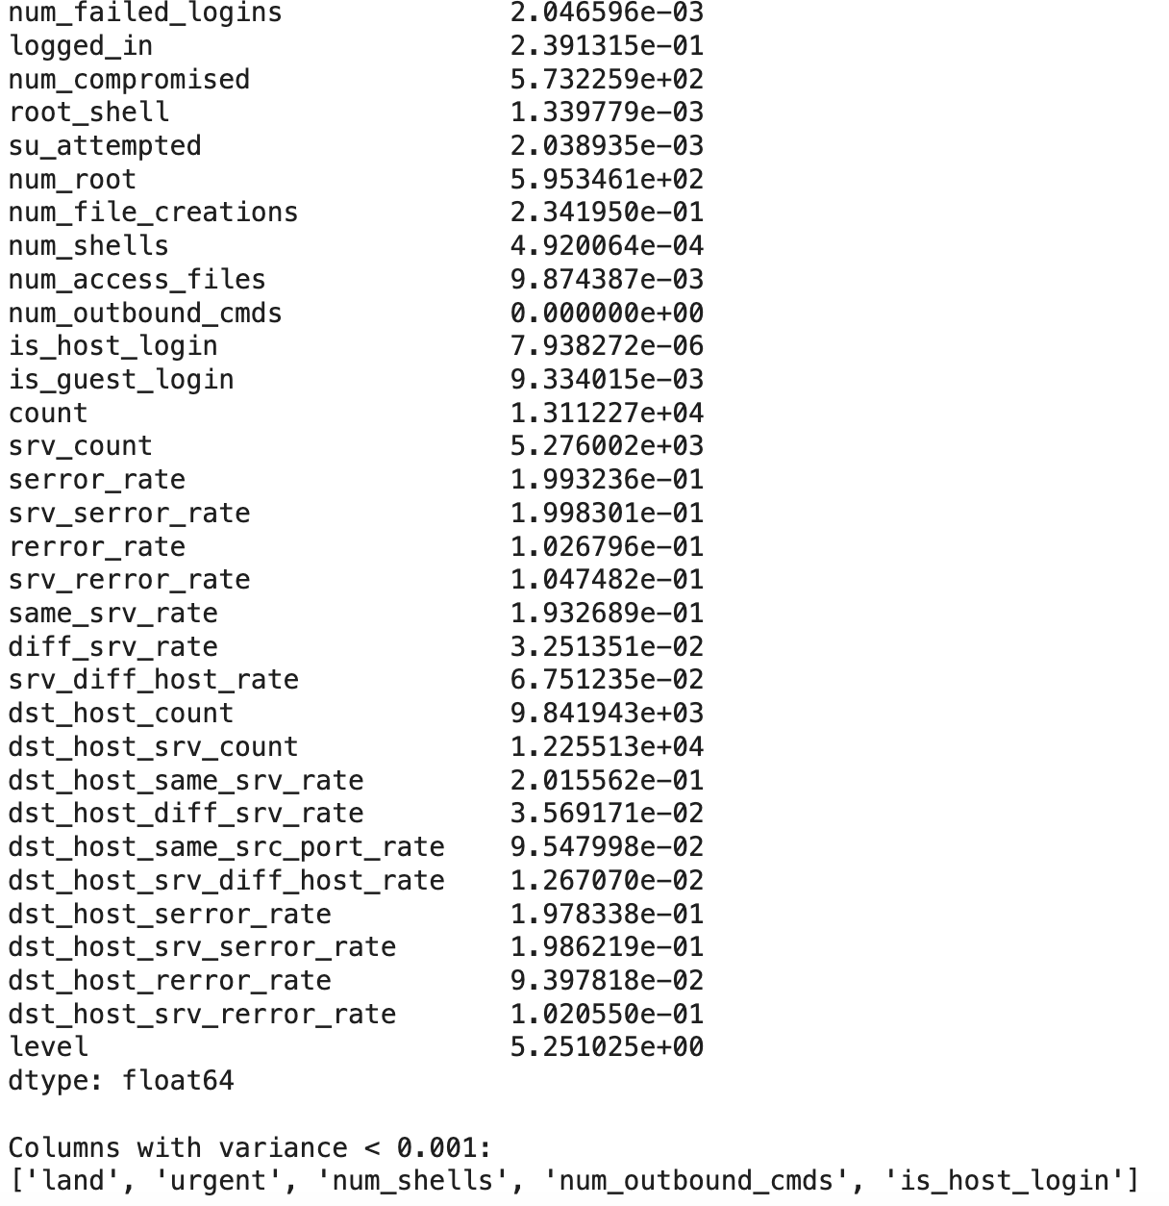
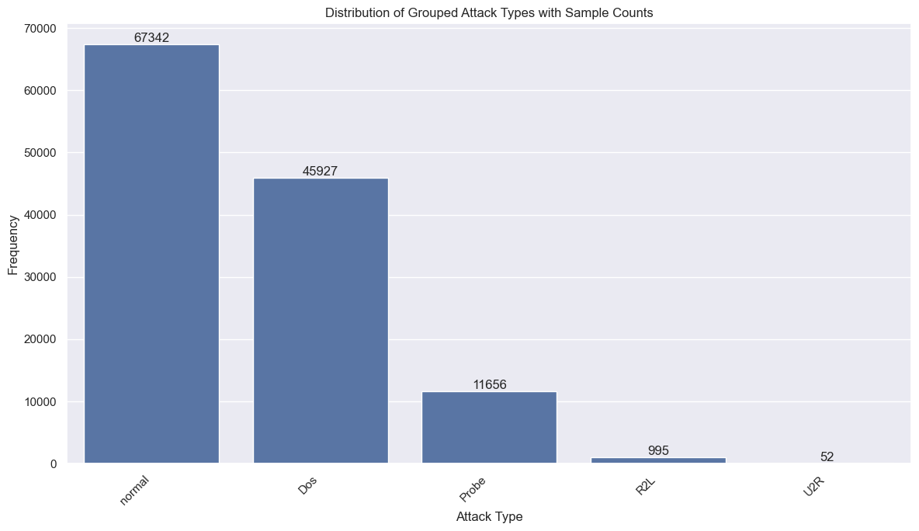
CLEANING & SAMPLING – ATTACK TYPE GROUPING AND LOW-VARIANCE FILTERING
Drop Variables with Low Variance
Grouped attack types
Original 22 attack types were grouped into 5 categories: Normal, DoS, Probe, R2L, U2R.
This simplifies the label space, but class imbalance remains significant.
5 features with variance < 0.001 (urgent, is_host_login) were removed.
This helps eliminate uninformative variables and reduces feature count from 43 to 38.
Grouping and filtering steps improve data quality and support more efficient model training.

Slide 9
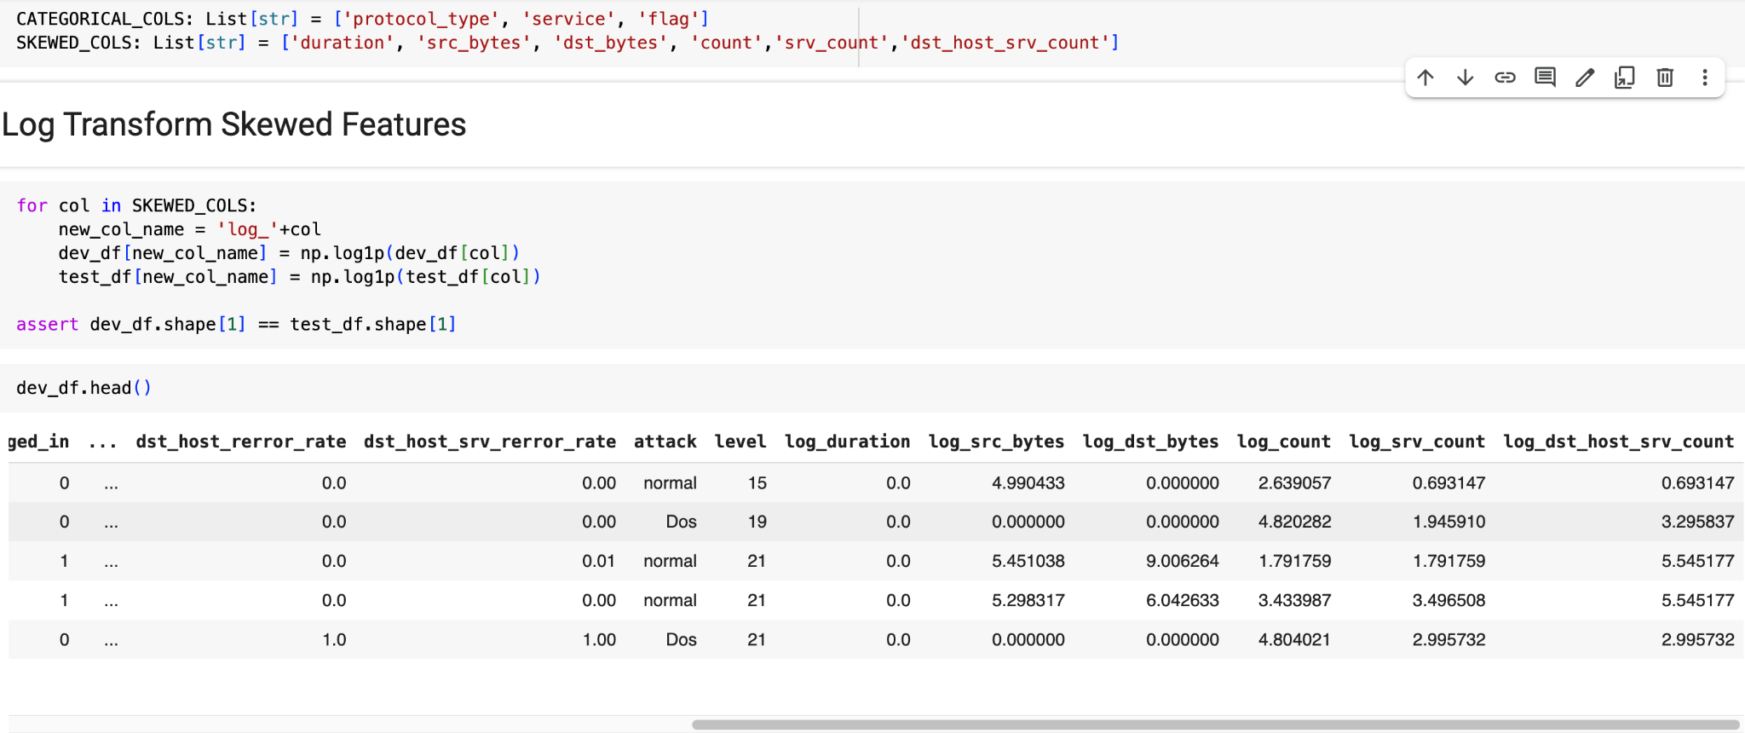
LOG TRANSFORM SKEWED FEATURES

Slide 10
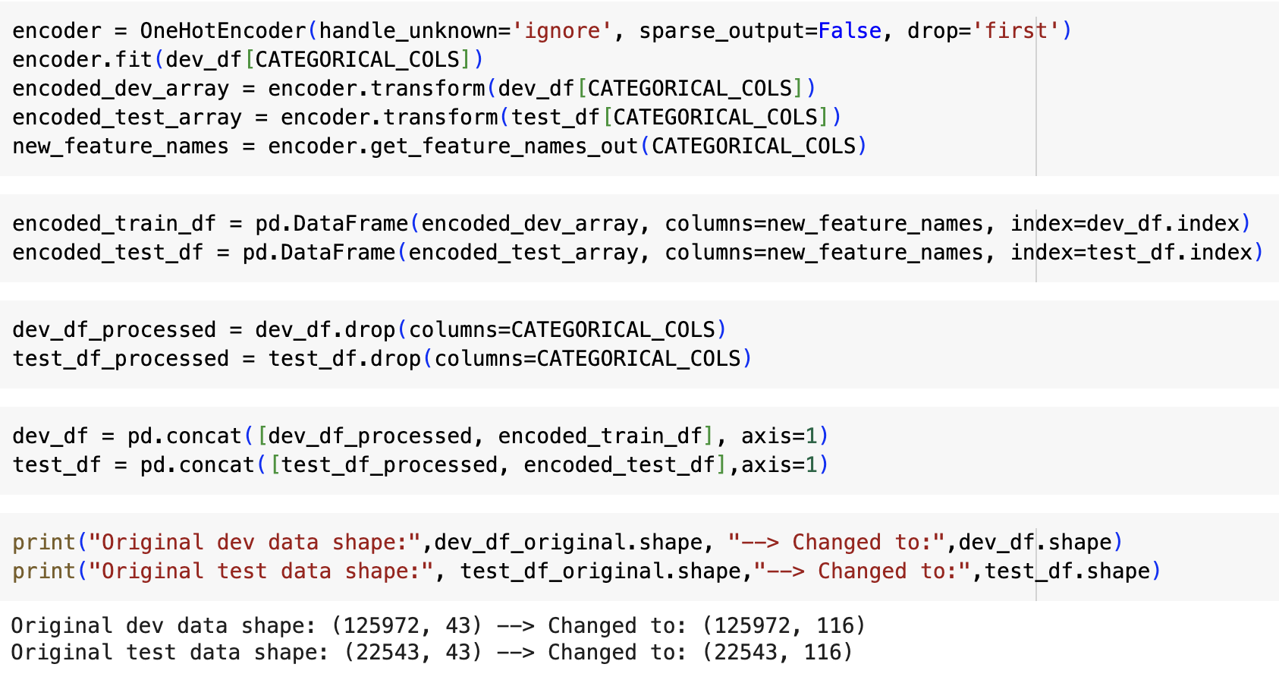
Encode categorical Features using OHE

Slide 11
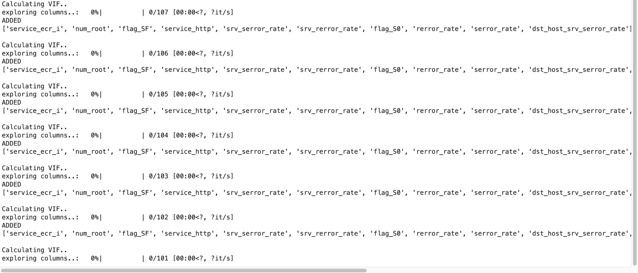
Handle Multicollinearity with Variance Inflation Factor (VIF)
From VIF calculation, we removed 15 variables - 'service_ecr_i', 'num_root', 'flag_SF', 'service_http', 'srv_serror_rate', 'srv_rerror_rate', 'flag_S0', 'rerror_rate', 'serror_rate', 'dst_host_srv_serror_rate', 'protocol_type_tcp', 'dst_host_srv_rerror_rate', 'same_srv_rate', 'dst_host_same_srv_rate', 'dst_host_serror_rate'

Slide 12
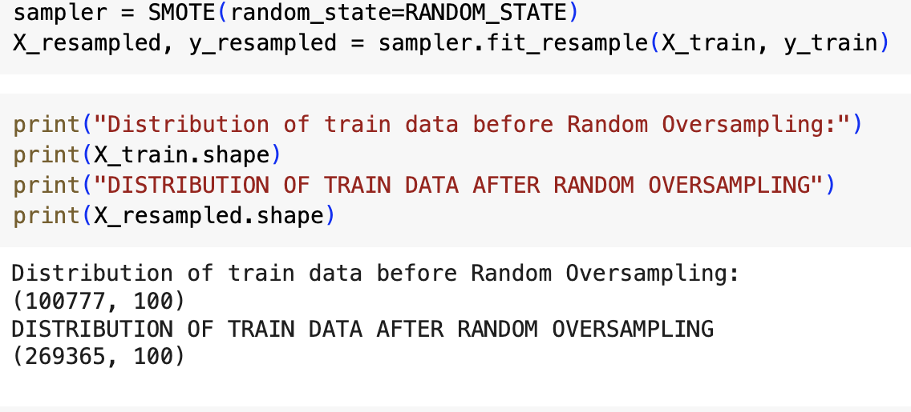
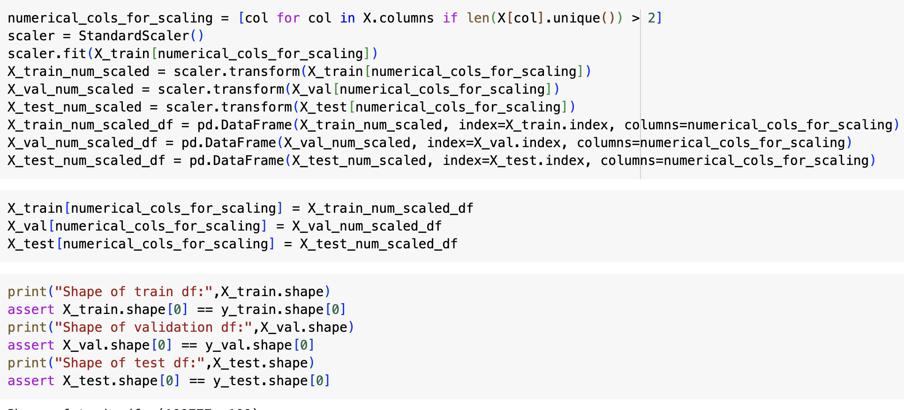
Handling Class Imbalance with SMOTE
SMOTE transformed our training data into a balanced and diverse sample set, supporting fairer and more robust classification performance.
To address the severe class imbalance in the training dataset, we applied SMOTE (Synthetic Minority Oversampling Technique). Before resampling, the training set had 100,777 instances with highly skewed class distribution. After applying SMOTE, the dataset was expanded to 269,365 samples, ensuring that each of the five classes — Normal, DoS, Probe, R2L, and U2R — contained exactly 53,873 instances.
This synthetic balancing technique helps prevent model bias toward majority classes, particularly important for underrepresented attacks like U2R and R2L. It also provides the model with enough minority samples to learn meaningful patterns.

Slide 13
PROPOSED MACHINE LEARNING TECHNIQUES
Tree-based models (Random Forest, XGBoost, LightGBM, Explainable boosting machine)
Support Vector Machines (SVM) with kernels
Deep Learning-based models
[Hyperparameter Candidates to Search for Each ML Model]
We plan on using K-fold cross validation and Grid search algorithm to find optimal ML models
# Random Forest Model
param_dist_rf = {
'n_estimators': randint(100, 500),
'max_depth': [10, 20, 30, None],
'min_samples_split': randint(2, 11),
'min_samples_leaf': randint(1, 11),
'max_features': ['sqrt', 'log2', None]
}
#XGBoost Classifier
param_dist_xgb = {
'n_estimators': randint(100, 500),
'learning_rate': loguniform(0.01, 0.3),
'max_depth': randint(3, 10),
'subsample': uniform(0.6, 0.4),
'colsample_bytree': uniform(0.6, 0.4),
'gamma': [0, 1, 5]
}
#Light GBM
param_dist_lgbm = {
'n_estimators': randint(100, 500),
'learning_rate': loguniform(0.01, 0.3),
'num_leaves': randint(20, 60),
'max_depth': [-1, 10, 20, 30],
'subsample': uniform(0.6, 0.4),
'colsample_bytree': uniform(0.6, 0.4),
'reg_alpha': loguniform(1e-3, 1.0),
'reg_lambda': loguniform(1e-3, 1.0)
}
#Explainable Boosting Machine
param_dist_ebm = {
'learning_rate': loguniform(0.01, 0.2),
'max_leaves': randint(2, 10),
}
#SVM with RBF Kernel
param_dist_svm = {
'C': loguniform(0.1, 100),
'gamma': loguniform(1e-4, 1e-1)
}

